Slide 1



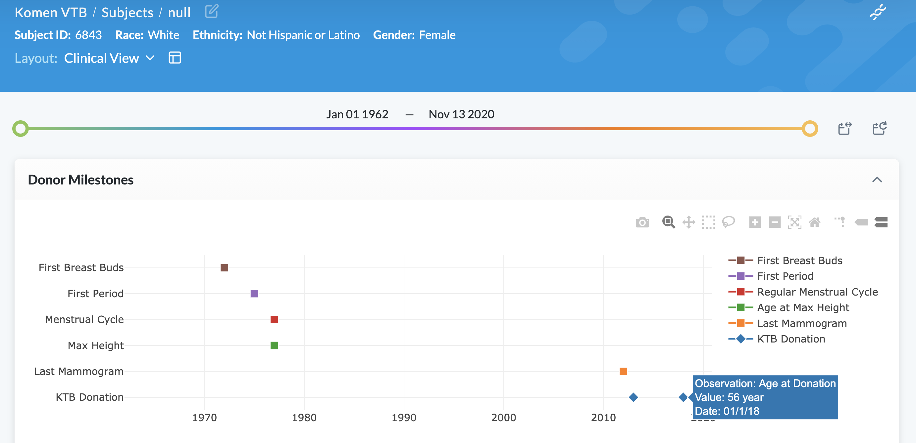
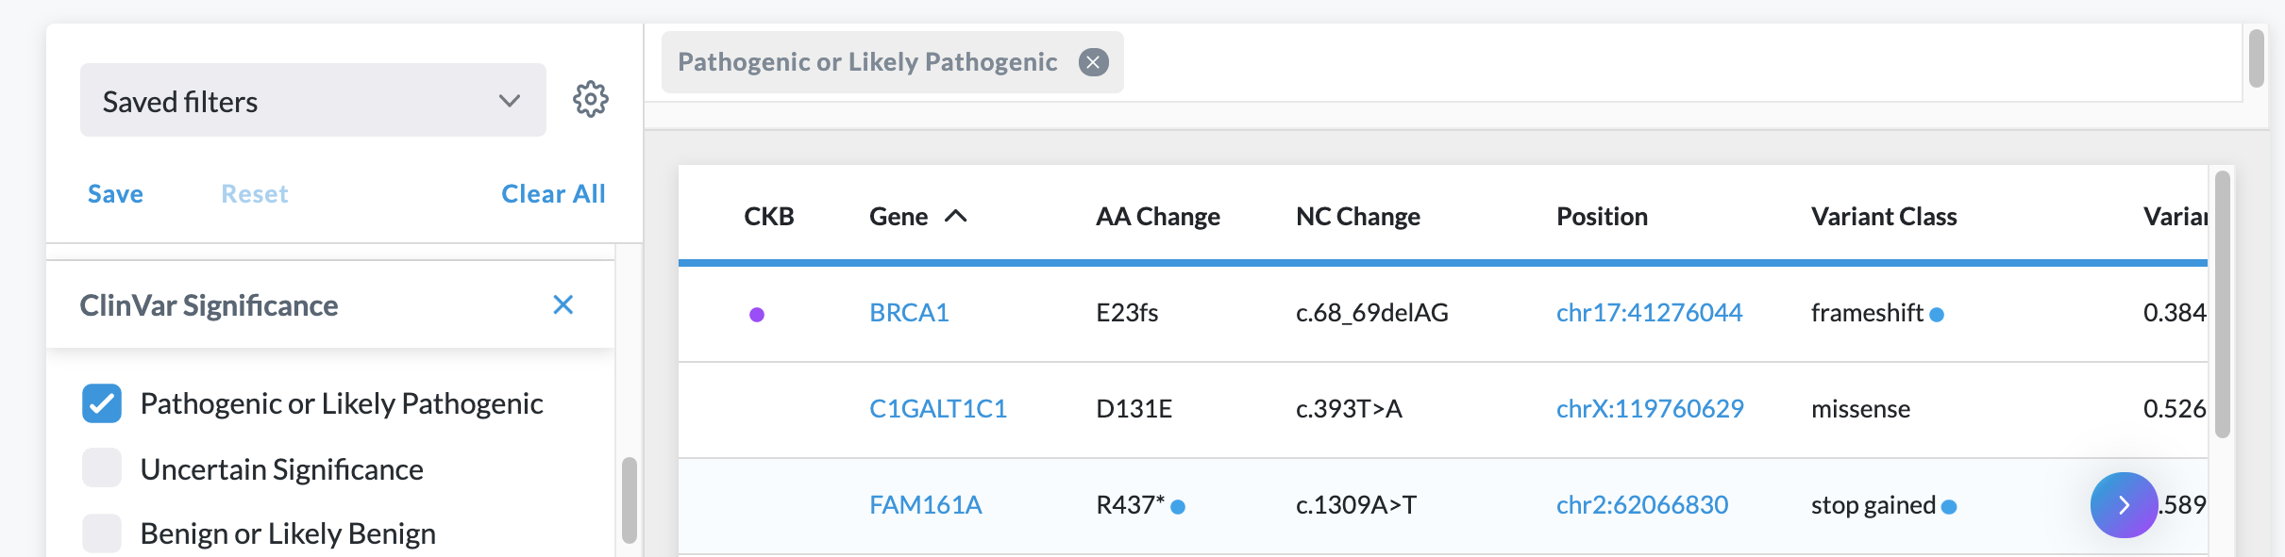
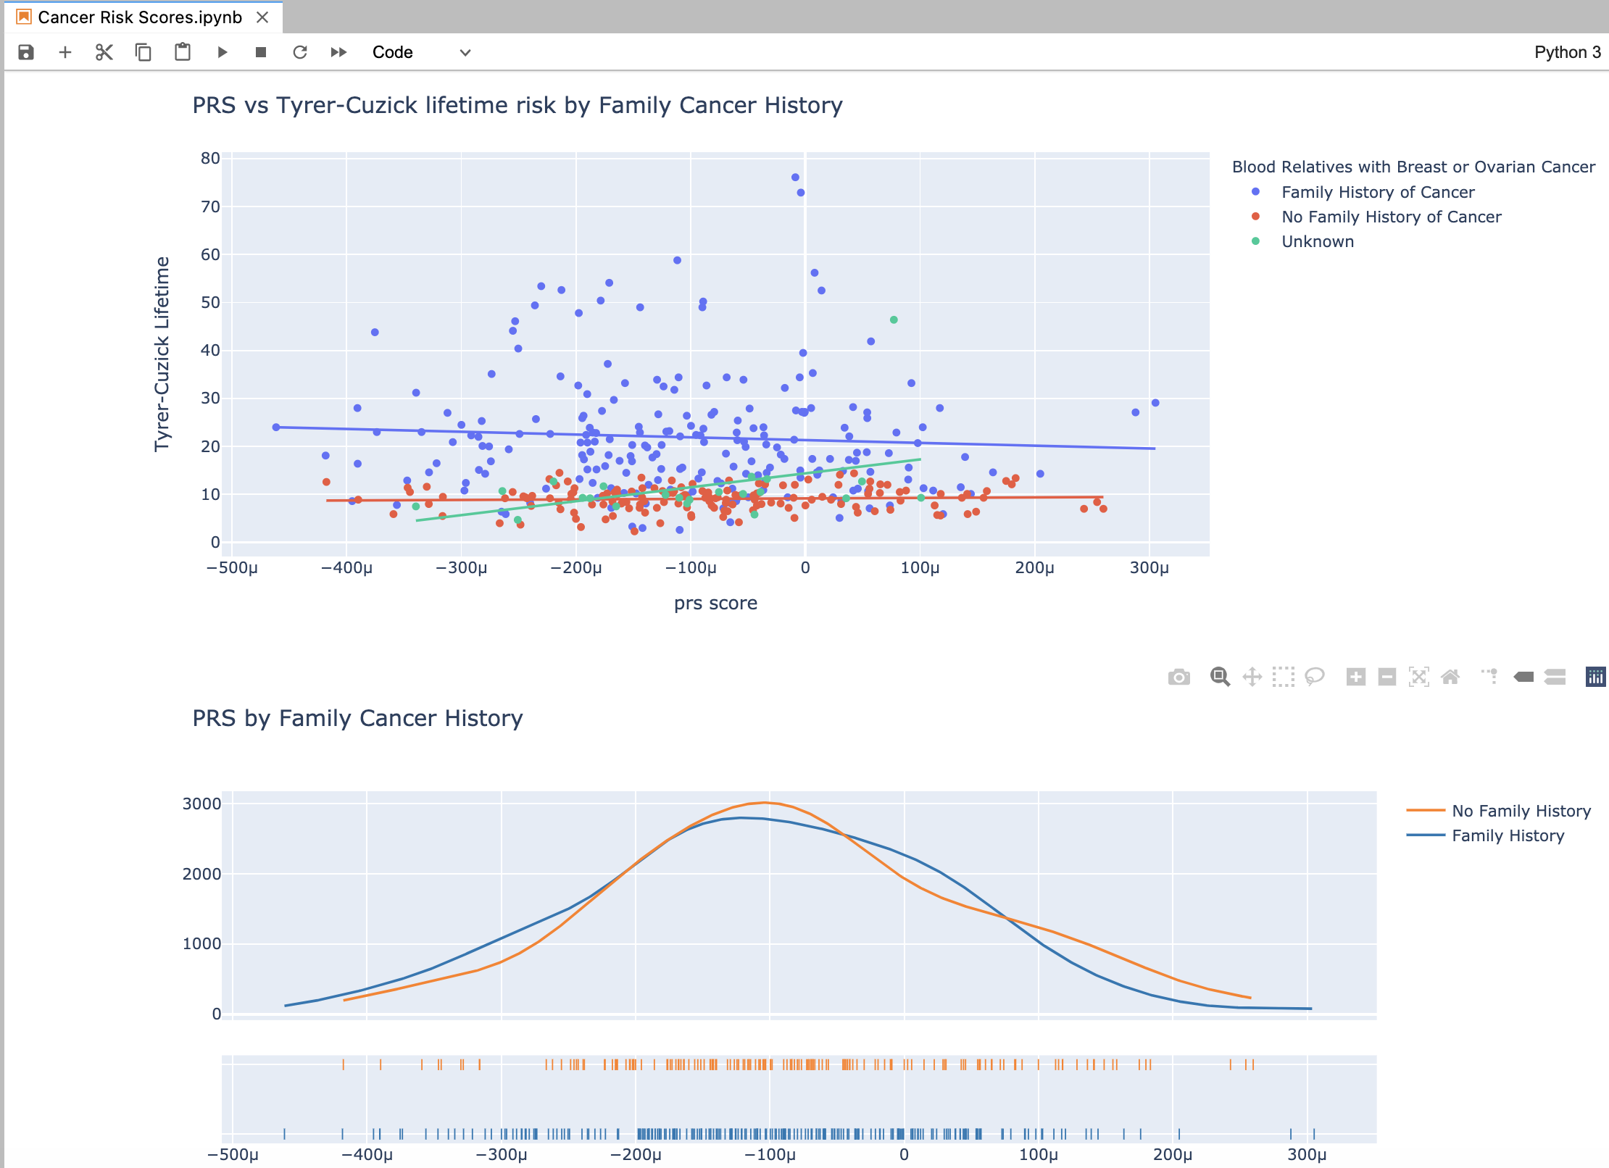
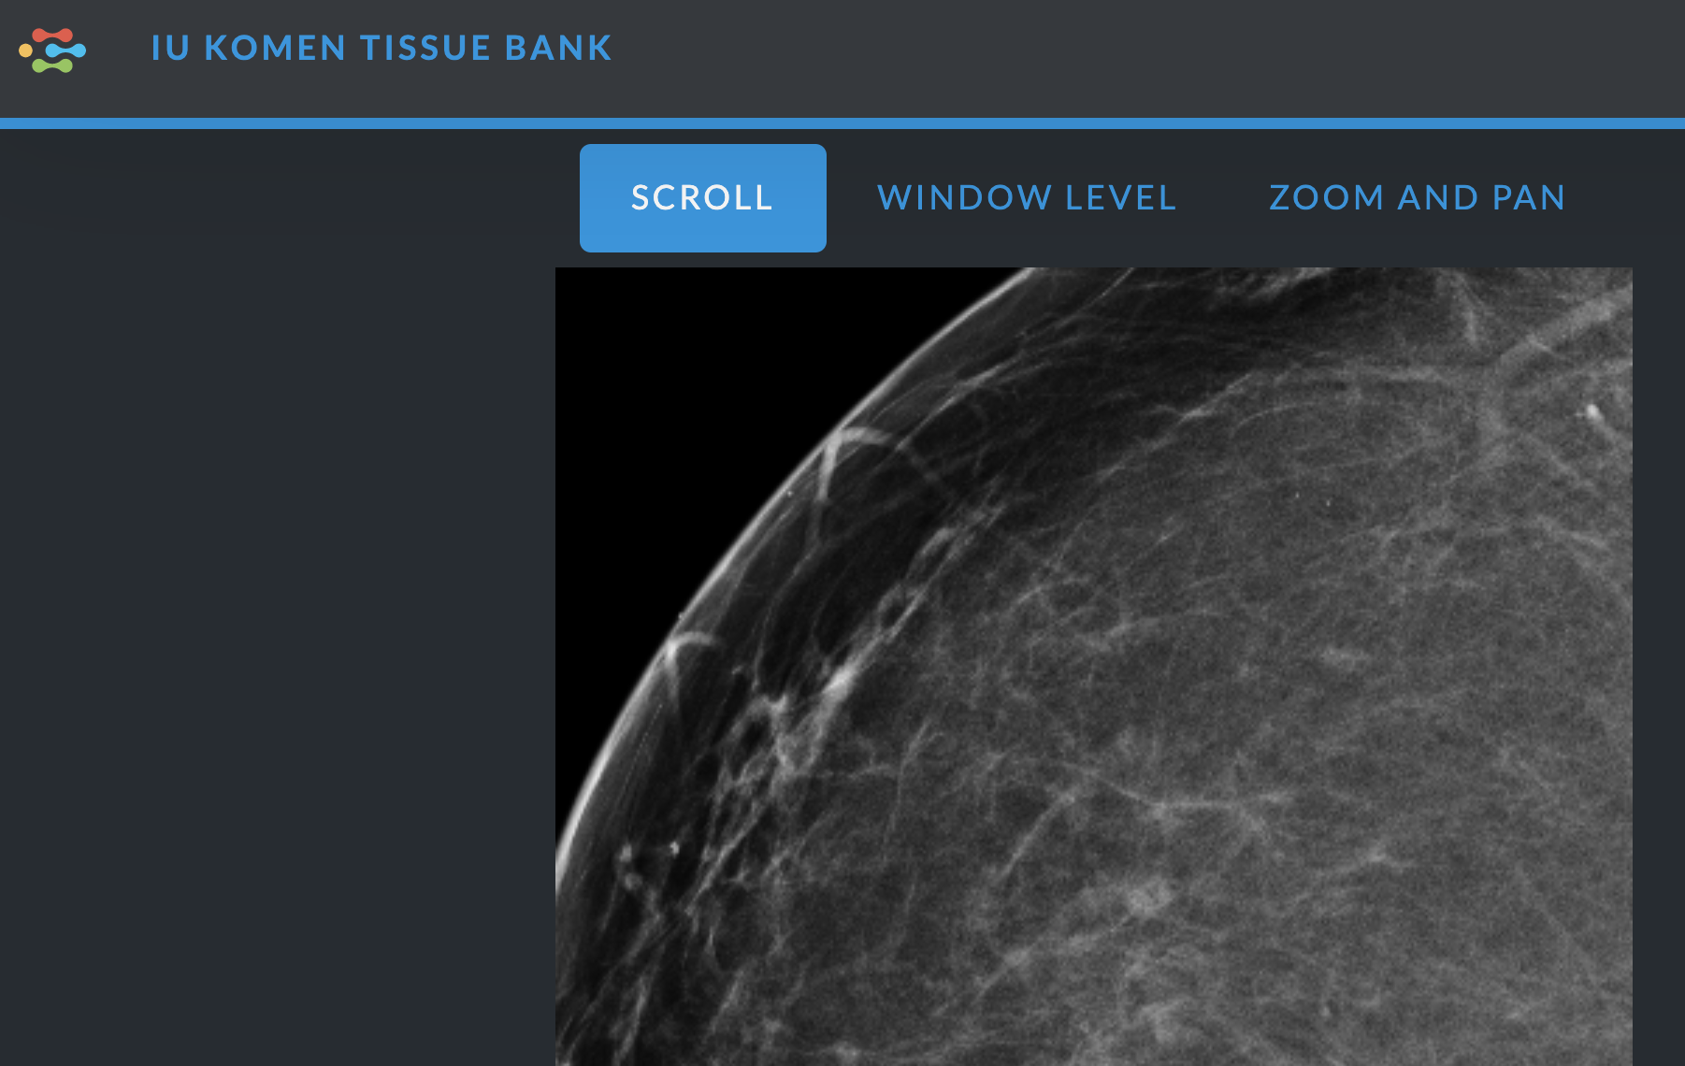
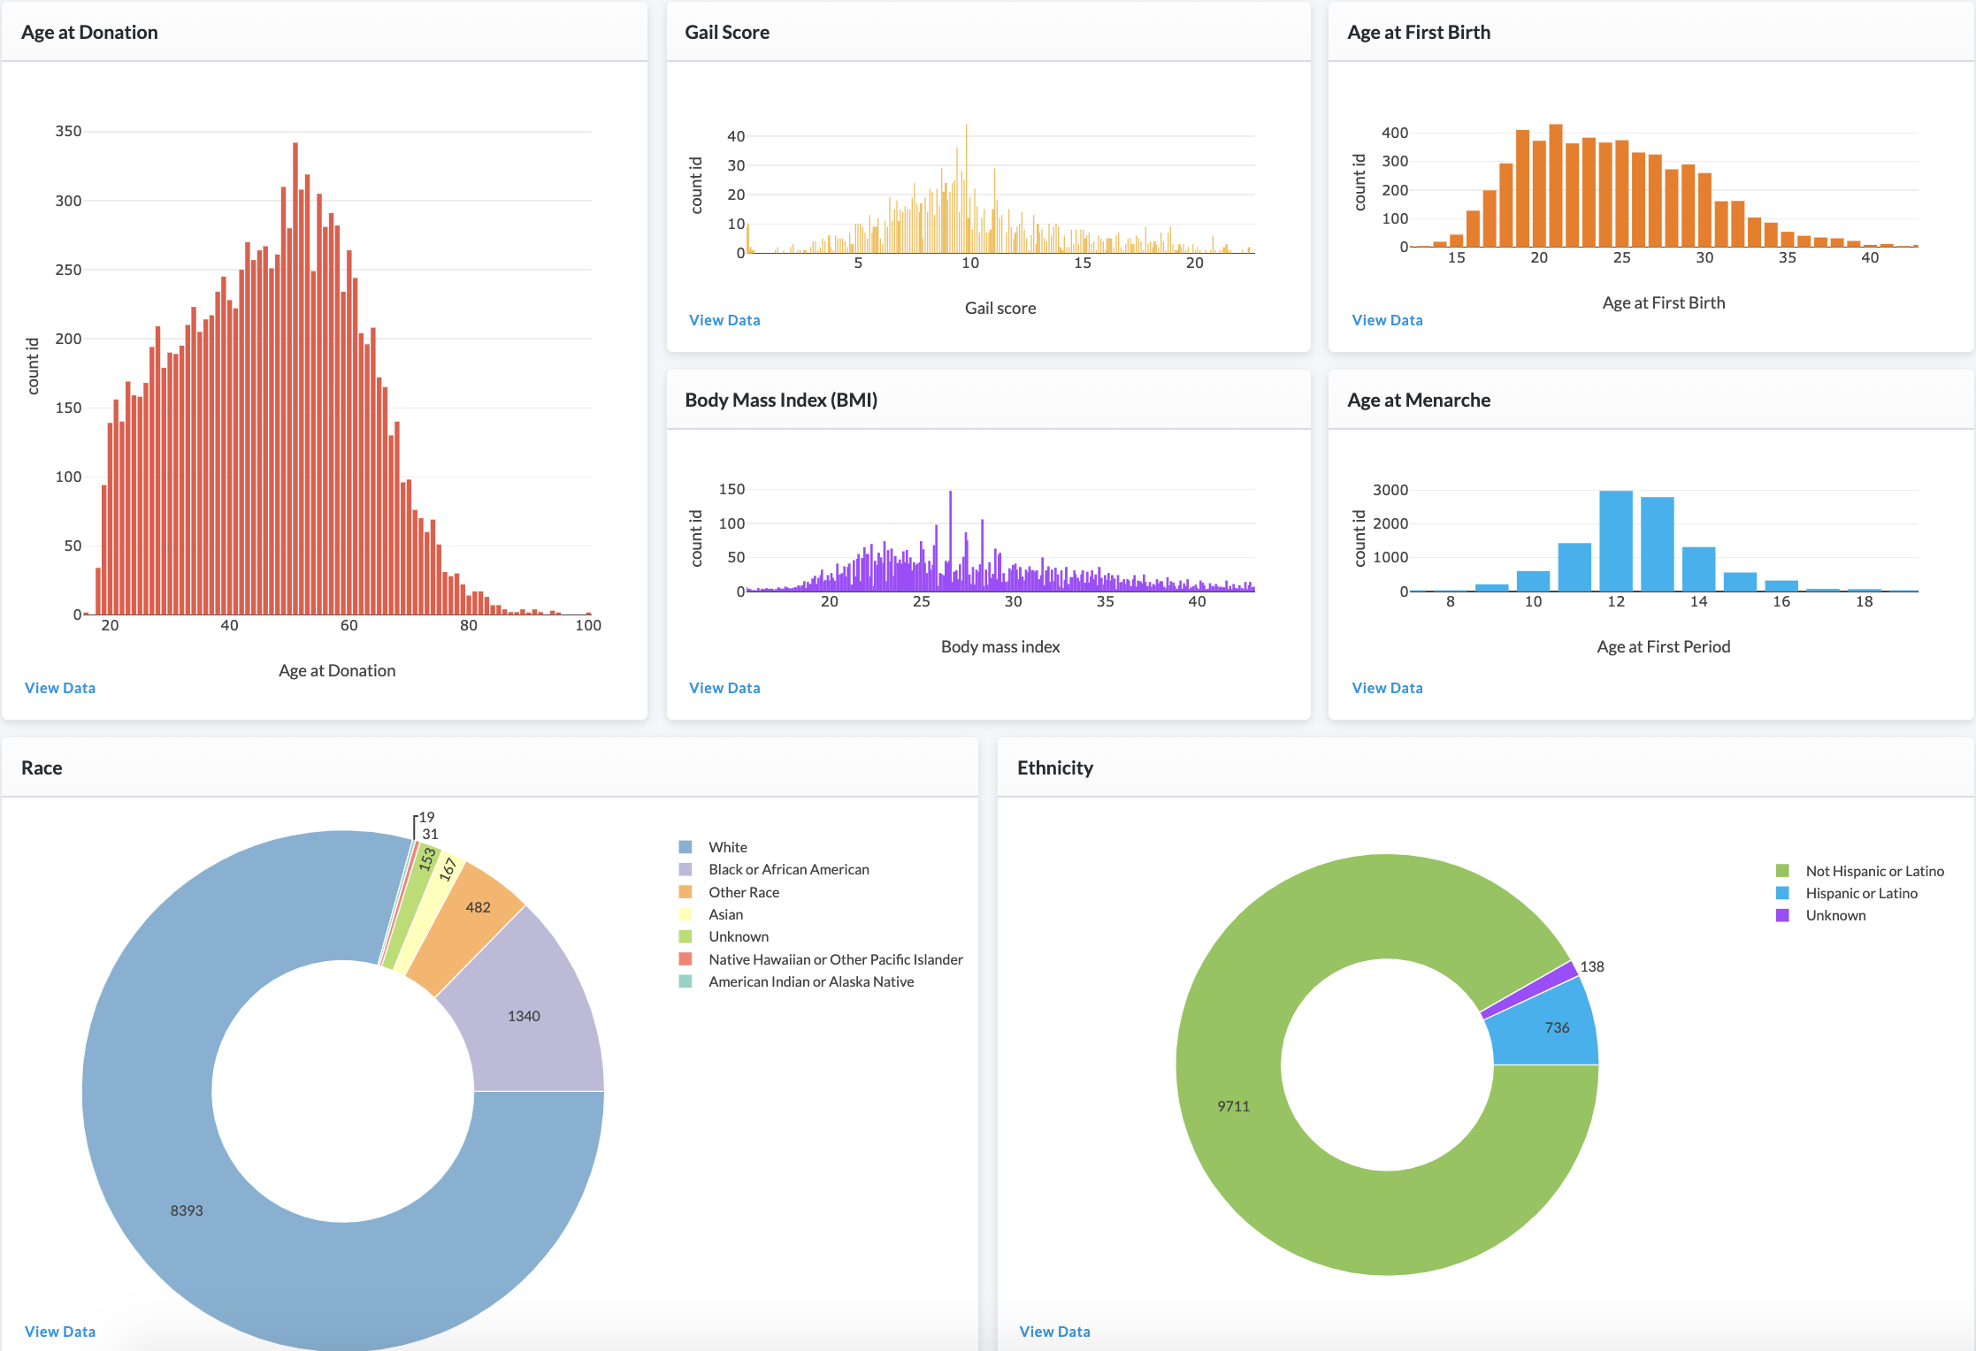
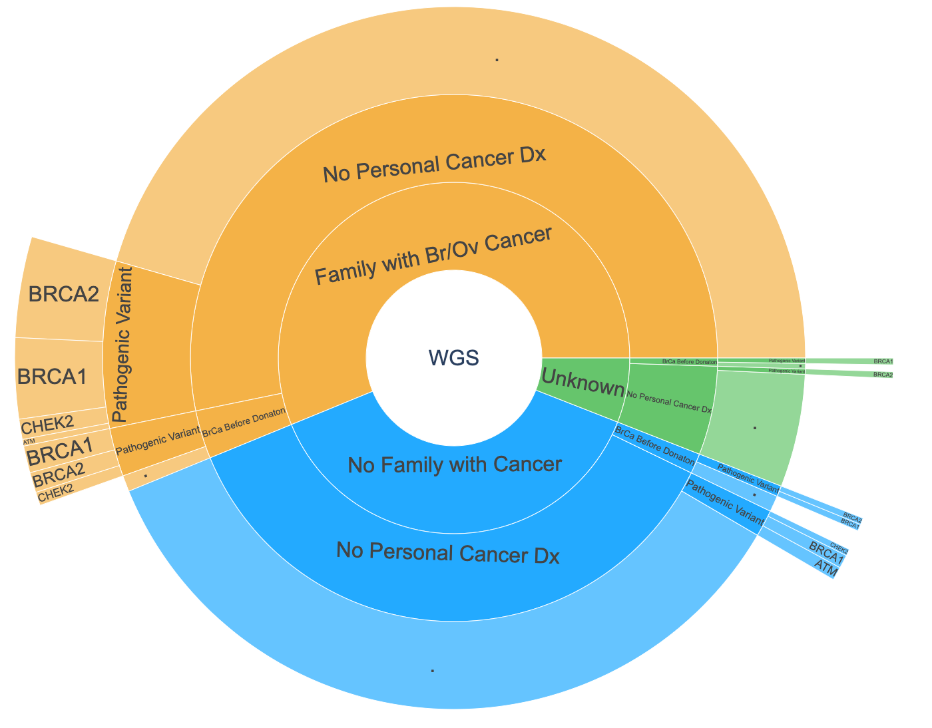
Advanced precision health resources in the Susan G Komen Tissue Bank at the IU Simon Comprehensive Cancer Center
TISSUE BANK
IU SIMON
CANCER CENTER
AT THE
Steven M Bray¹, Swee Seong Wong¹, Mark Schroering¹, Baiju G Parikh¹, Kevin C Wood¹, Samuel T Rysdyk², Jill E Henry², Natascia Marino³, Milan Radovich³, Anna Maria V. Storniolo³
¹LifeOmic, Indianapolis, IN ²Susan G. Komen Tissue Bank at IU Simon Comprehensive Cancer Center, Indianapolis, IN ³Indiana University School of Medicine, Indianapolis, IN
San Antonio Breast Cancer Symposium
December 8-11, 2020
Background
Individual KTB Donor Timeline
Omics Explorer
Understanding how hereditary, lifestyle and demographic risk factors influence the development of breast cancer is critical for its prevention and treatment. For this purpose, the Susan G. Komen Tissue Bank at the IU Simon Comprehensive Cancer Center (KTB) serves as the world’s primary repository for normal breast tissue and blood samples from healthy women (~5,500 tissue + blood donors and ~4,500 blood-only donors). In addition, KTB has received mammograms, H&E images and additional longitudinal health and wellness data from its donors via ongoing annual surveys. Whole genome sequencing has also recently been completed on a subset of 500 donors, including ~125 initially healthy donors who later went on to develop breast cancer. To make these disparate, multi-modal data accessible to the larger research community and add advanced precision health analytics capabilities to the KTB database, LifeOmic’s Precision Health Cloud (PHC), a secure healthcare-compliant cloud platform, was chosen to host the KTB data moving forward. The PHC provides browsing and querying capabilities across all data including genomic, demographic, histology, donor surveys, and scanned images. Data from donors can be viewed individually as well as analyzed across cohorts of interest. Computation resources, such as informatics workflows and machine learning infrastructure, are available on the same secure environment to leverage the power of cloud computing without having to download large files. This is in addition to visual and custom analytics using Jupyter Notebooks accessible to collaborators.
The Omics Explorer in PHC integrates extensive variant annotation and filtering capabilities to allow easy and efficient identification of variants of interest. This screenshot shows ClinVar pathogenic variants in a KTB donor with a BRCA1 E23fs germline mutation.
Cancer Risk Predictions
Methods
Individual donor data can be viewed longitudinally on a timeline to visualize key developmental milestones. Additional data from yearly follow up questionnaires are also available for review for each individual.
We loaded all available KTB data from ~10,000 donors into the PHC. Donor-reported data collected at the time of donation and subsequent follow-up questionnaire responses were loaded as FHIR Observations and Medications in the PHC. Additional imaging and genomic data loaded into the PHC include approximately 12,000 mammogram images, 5,000 H&E images, 5,000 ancestry-informative genotypes and 500 VCF and BAM files from whole genome sequencing. A timeline view of each donor shows data collected from each donation and follow-up surveys. All genetic variants were annotated upon ingestion into the PHC with functional effect on genes, population allele frequency, ClinVar clinical significance and in silico predictions for functional impact.
We calculated genomewide breast cancer polygenic risk scores (PRS) for donors using PLINK2 with the Breast Cancer PRS published by Mavaddat et al¹, including 3,820 SNPs. PRS were compared with the survey-based Tyrer-Cuzick risk measures².
Image Viewer in PHC
H&E and/or mammogram images can be viewed directly in the PHC. A built-in image viewer allows researchers to analyze images in the cloud without the need to download large files – as demonstrated for a mammogram image shown here. ~5,000 H&E stains are available and more than 12,00 mammogram images.
KTB Donor Demographics
Whole Genome Sequencing
Breast cancer polygenic risk scores (PRS) were compared to Tyrer-Cuzick (TC) lifetime risk scores using advanced analytics tools in the Jupyter Notebooks integration in PHC. The scatter plot shows little correlation between the PRS and TC scores regardless of family history of cancer. The histogram density also shows no significant difference between PRS distribution based on family history of cancer.
Conclusions
We have shown how hosting KTB data in the PHC opens new opportunities for advanced precision health research for breast cancer researchers worldwide. As more specimens and diverse data sets including genomic, longitudinal and imaging information are being tracked and deposited into KTB, this resource will continue to grow to enable diverse research needs.
References
Germline whole genome sequencing was recently completed for 404 KTB donors and uploaded to the PHC. Using genomic annotations and tools in PHC, we identified 49 of the 404 (12%) donors as carriers of a pathogenic variant in a known breast cancer gene (ATM, BRCA1, BRCA2, CHEK2). The majority of pathogenic variants were identified in donors with a family history of breast or ovarian cancer, with or without a personal diagnosis of cancer. Nearly 20% of donors without a family history of cancer (or unknown history) also carry a pathogenic variant.
References
1) Mavaddat, Nasim, Kyriaki Michailidou, Joe Dennis, Michael Lush, Laura Fachal, Andrew Lee, Jonathan P. Tyrer, et al. The American Journal of Human Genetics 104, no. 1 (January 2019): 21–34.
2) Tyrer, Jonathan, Stephen W. Duffy, and Jack Cuzick. Statistics in Medicine 23, no. 7 (2004): 1111–30.
Data from >10,500 donors to KTB were loaded into PHC, including demographic, reproductive history, lifestyle, imaging and genomic data. Data can be viewed for individual donors and analyzed across the entire population. Shown here are the distribution of age at donation, Gail score, BMI, age at fist birth, age at menarche and race/ethnicity.
Acknowledgements
Data from the Susan G. Komen Tissue Bank at the IU Simon Comprehensive Cancer Center were used in this study. We thank contributors, including Indiana University who collected data used in this study, as well as donors and their families, whose participation made this work possible.
This presentation is the intellectual property of the presenter. Contact steven.bray@lifeomic.com to reprint or distribute.

